Slide 1
Chat project
Ksenia Rogova

Slide 2
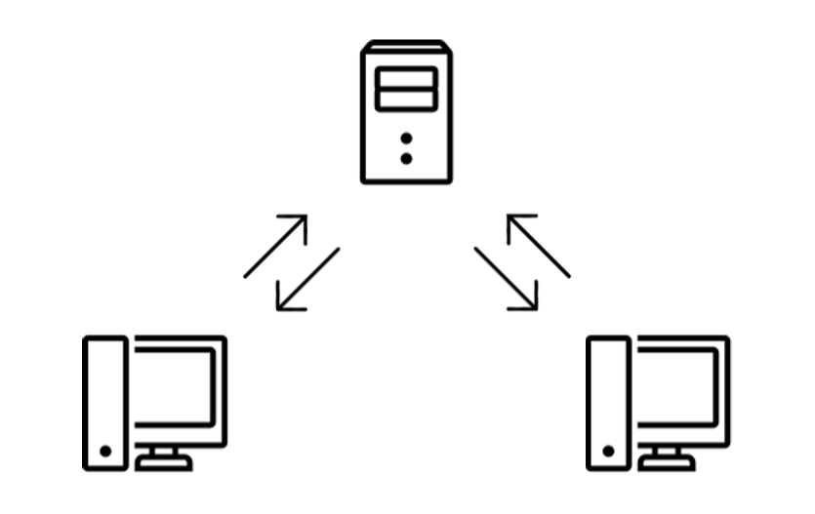
Project
Multiplayer chat
<номер>

Slide 3
Specification
Plain C
Linux
Sockets & Epoll
TCP/IP
Client: netcat or similar
<номер>

Slide 4
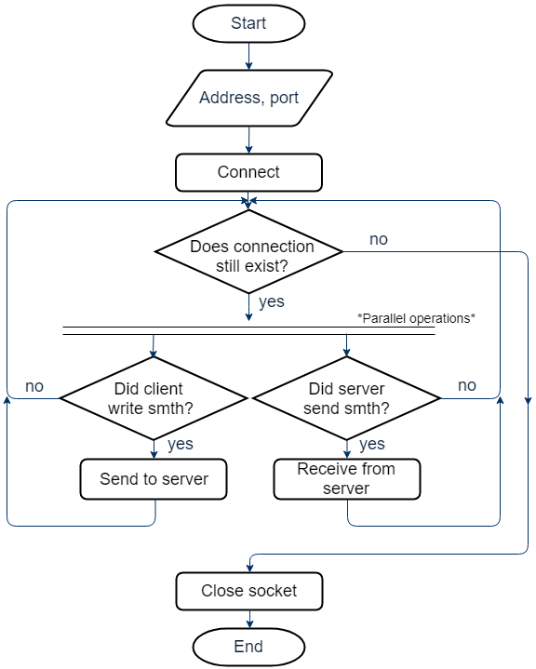
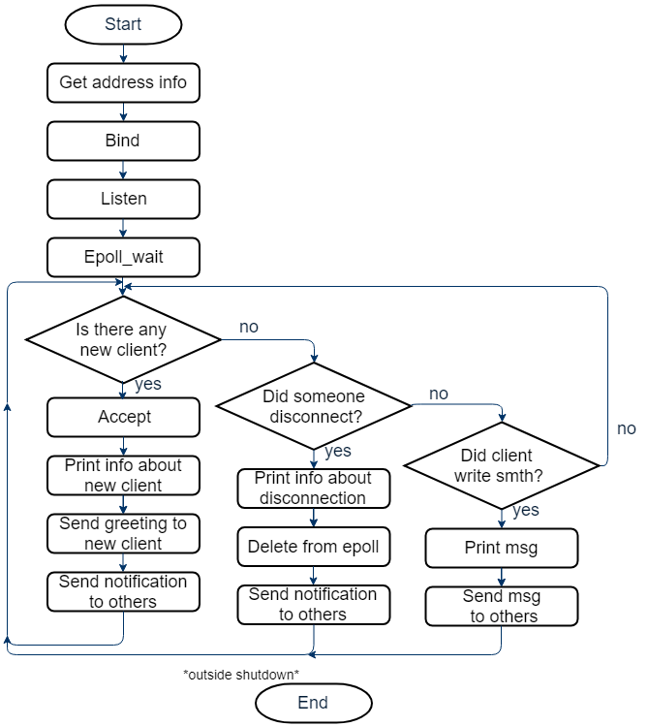
Client & Server
<номер>

Slide 5
Protocol
password : incorrect
Login
name
Password
message
/login
password : correct
Common room
Start
password
/signup
Signup
Signup
password
/connect common
name
/connect alpha
/logout
Room Alpha
/logout
message
<номер>

Slide 6
Protocol
States
Start
Login
Password
Signup
Signup password
Common room
Alpha room
Commands
/login
/signup
/connect <to>
/help
/roomlist
/logout
<номер>

Slide 7
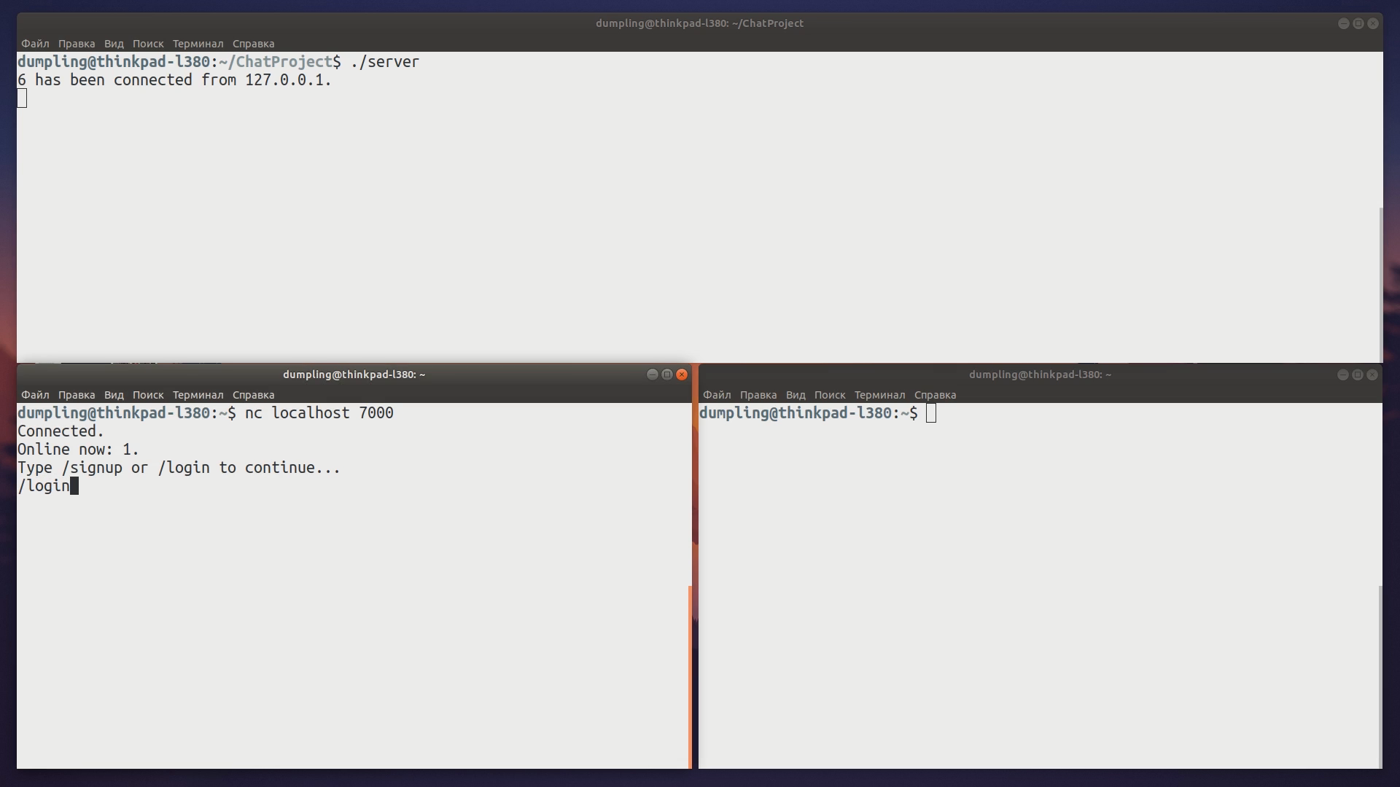
<номер>

Slide 8
Results
During the project I
Made ‘to-read’ list
Learned plain C
Used Linux for the first time
Made first Git-commit
Wrote my first Makefile
Worked with SQLite
Read RFC 1459 (IRC protocol)
<номер>

Slide 9
Thanks for your attention!
ksenia.rogova99@gmail.com
<номер>

